Slide 1

Global EV Sales 2010 - 2035
Presented By:
Yogi Aadeshkumar
Batch No: 450

Slide 2
About me
My name is Yogi Aadeshkumar. I have completed my B.Tech in Information Technology from Silver Oak University, Ahmedabad (2021-2025).
I want to learn Data Science because I enjoy finding useful insights from data to help make better decisions. I also like working with numbers and tools to uncover patterns that solve real-world problems.
LinkedIn profile :LinkedIn

Slide 3
Agenda
Business Problem
Problem Statement
Objective
Dataset Overview
Data Preprocessing
Dashboard
Key Insights
Conclusion
Recommendations

Slide 4
Business Problem
The global electric vehicle (EV) market is growing rapidly, but this growth is uneven across regions, technologies, and time periods, making it difficult to identify key markets and trends.
Problem Statement
Uneven EV growth makes data hard to understand, which creates problems for governments and businesses in planning policies, investments, and charging infrastructure.

Slide 5
Objective
Comparing EV adoption across vehicle types like cars, buses, two-wheelers, and trucks in different countries and regions
Evaluating powertrain technologies (BEV, PHEV, FCEV) and their adoption over time
Understanding sales, stock, and energy consumption trends
Highlighting key years of growth, peak adoption, and technology shifts

Slide 6
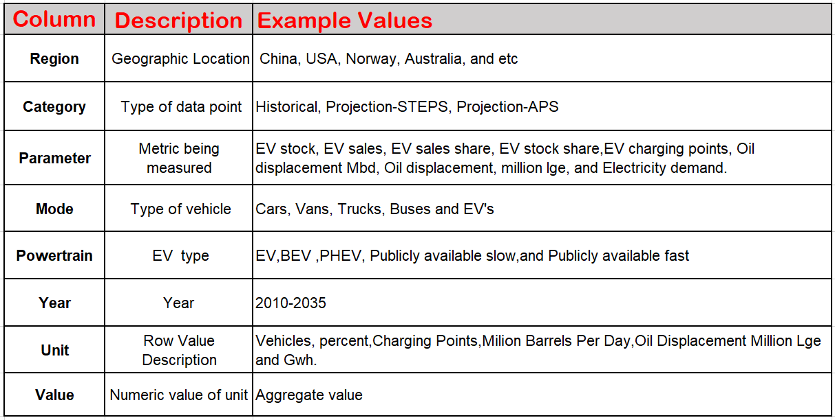
Dataset Overview
Dataset Structure
8 Columns
10,450 Rows

Slide 7
Data preprocessing
Data Ingestion
Imported the IEA Global EV Data from a CSV file into Power BI using Power Query.
This helped in cleaning, transforming, and checking the data before analysis.
Data Type Standardization
Standardized column data types (e.g., year as Whole Number, value as Decimal, categorical fields as Text).
Removal of “World” from the Region Column
Creation of Analytical Measures
Created DAX measures for EV stock, EV sales, energy use, cumulative values, and year-over-year comparison.
Used measures instead of columns to allow dynamic analysis across year, region, category, and powertrain filters.

Slide 8
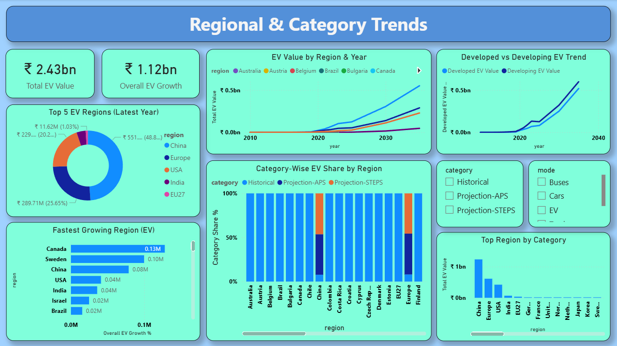
Dashboard

Slide 9
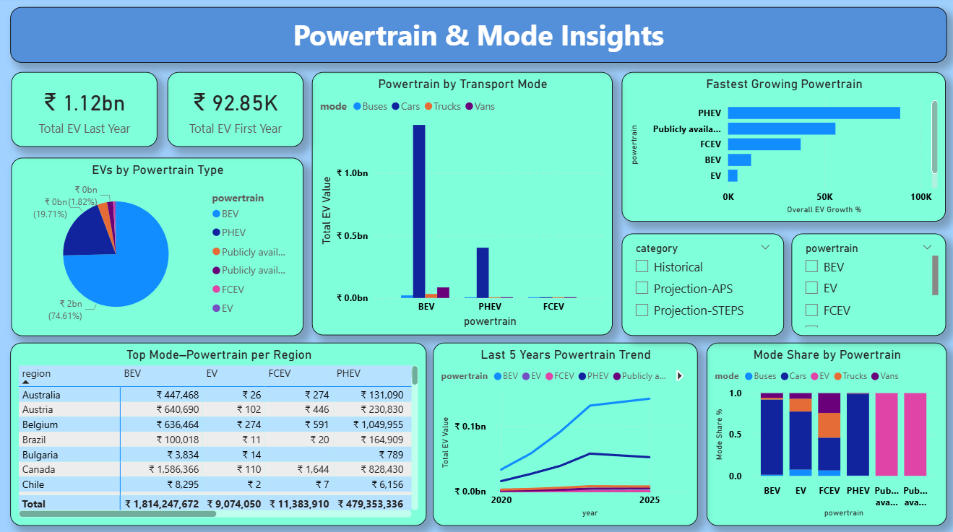

Slide 10
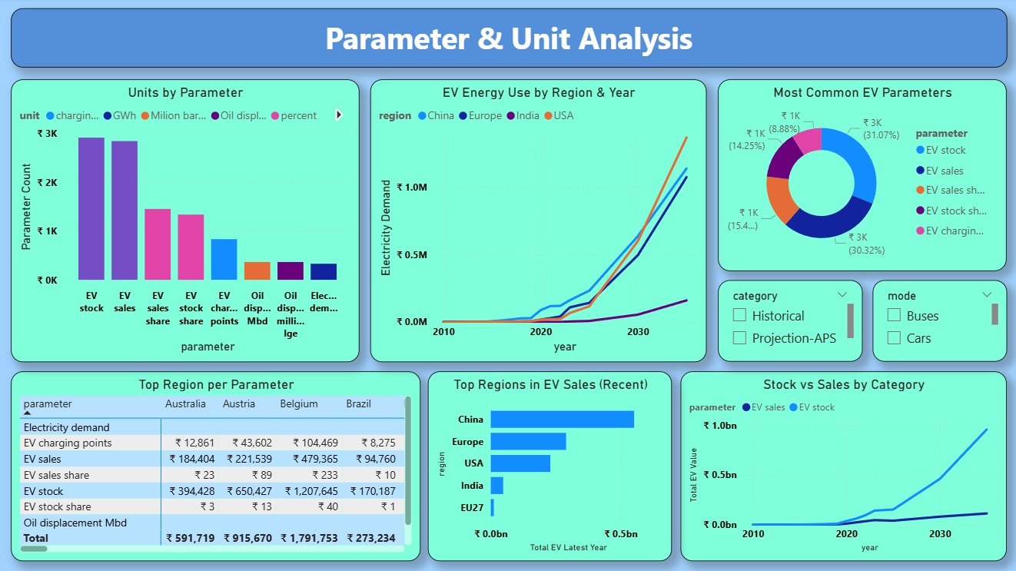

Slide 11
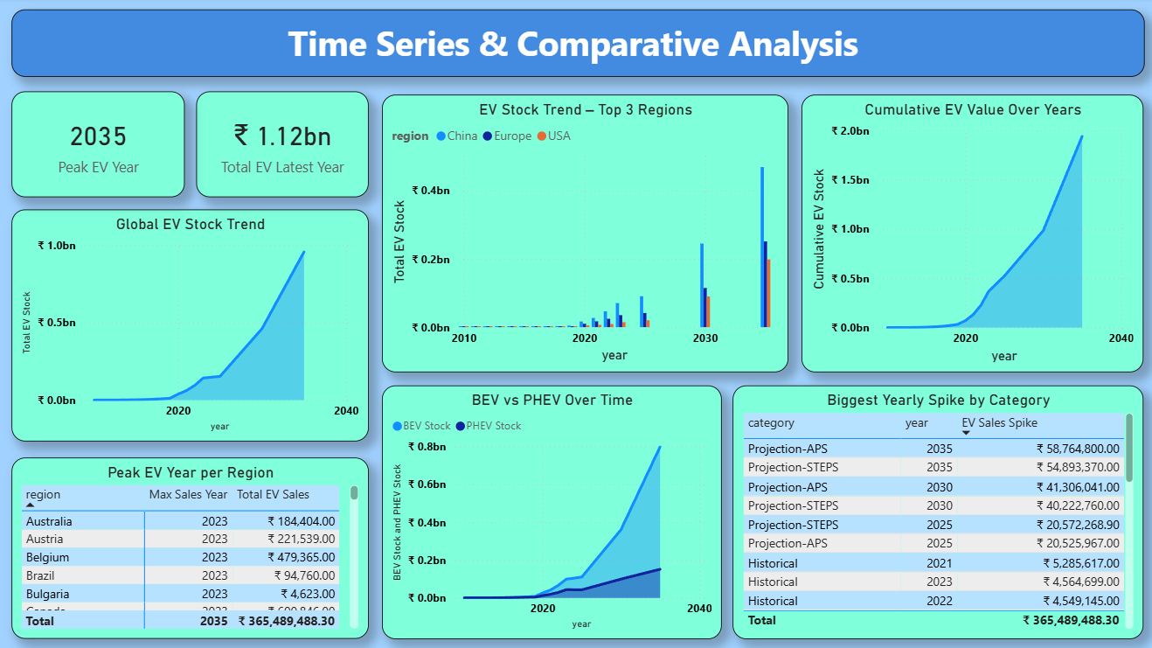

Slide 12
KEY INSIGHTS
Regional & Category Trends :
China has the highest EV adoption, showing strong overall EV growth across regions.
Powertrain & Mode Insights :
BEVs are the most common EVs, mainly used in cars, while vans are growing steadily in light commercial use.
Parameter & Unit Analysis :
EV sales and stock grow along with higher electricity use and more charging stations, showing the need for strong charging infrastructure.
Time Series & Comparative Analysis :
EV adoption grows slowly at first but increases rapidly after 2020, led mainly by China and Europe, reflecting the impact of strong policies, lower costs, and better technology.

Slide 13
Conclusion
China and BEVs will drive most of the global EV growth.
Passenger cars will lead EV adoption, and vans will grow fast in the commercial segment.
EV plans should change by region: the US and China should focus mainly on BEVs.
  RECOMMENDATINS
Governments should give better incentives and more charging stations where EV use is low.
More research and infrastructure are needed to improve EV technologies other than BEVs.
Clear and stable policies can help EVs grow faster, especially in developing countries.

Slide 14


Slide 15

THANK YOU

